Slide 1

Rockbuster Analytics
Findings and Recommendations by Anika Ahmed

Slide 2
Highlights
5 days
$2.98
$19.98
115 mins
PG-13
AVG Rental Duration
AVG Rental Rate
AVG Replacement Cost
AVG Film Length
Modal Ratings

Slide 3
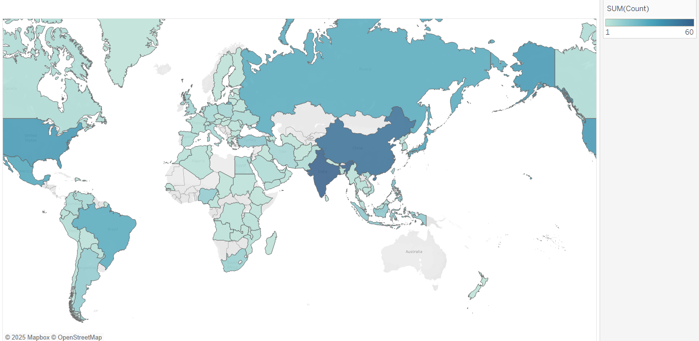
Geographical Breakdown of Customers
The map shows customer distribution across countries, where the darker shade represents higher number of customer and lighter shade represents lower.
Highest number of customers are in India following it is China.

Slide 4
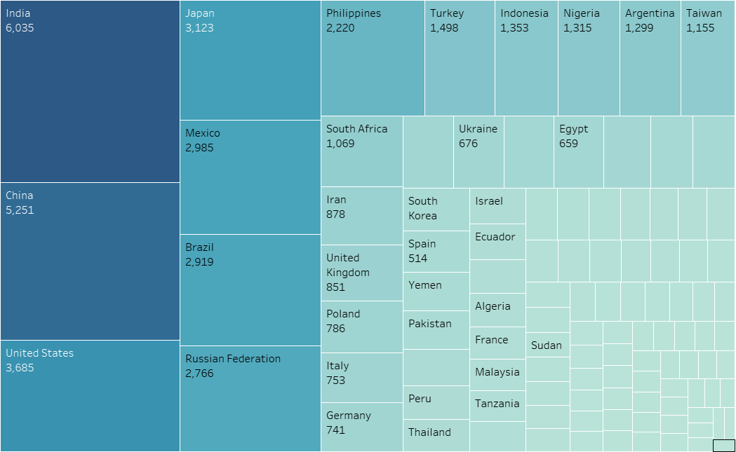
Amount Spent by City
Visualization shows highest amount spent in India of 6036.
Following it is China and USA of 5251 and 3685, respectively
Lowest spend in American Samoa of 48.

Slide 5
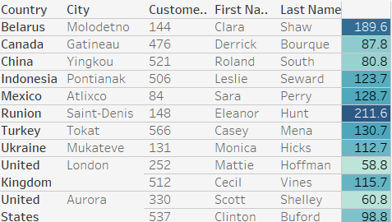
High Value Customers
These customers spent the highest on video rentals over the years.
The EU region contributes to the highest amount of rental overall, with Eleanor Hunt in Runion being the highest individual spender, spending of about 211.6
Therefore, future marketing plans should reserve a significant budget for the EU regions.

Slide 6
Summary of findings
Revenue drive is broadly spread around the different movies title.
Top Location Top customer locations are India, China, Japan, Mexico and United States
Potential Online platform has high potential if focused on the top performing geographical areas.

Slide 7

Recommendations
Prioritize top 10 countries and cities for online launch
Focus marketing on high-value customer segment
Invest in Top Categories and boost content acquisition and promotion for best-performing genres
• Continue monitoring with regular SQL based reporting

